Slide 1
ECOLOGY
ENVIRONMENTAL ISSUES

Slide 2
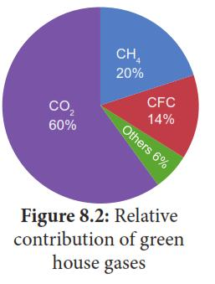
GREEN HOUSE EFFECT
Green house effect is a process by which radiant heat from the Sun is captured by gases in the atmosphere that increase the temperature of the Earth ultimately.

Slide 3
GLOBAL WARMING
The increase in mean global temperature ( highest in 4000 years) due to increased concentration of green house gases is called global warming
Green house gases include CO2, CH4,N2O & variety of manufactured chemicals like chlofluorocarbon (CFC)
Effects Of Global warming
Low agricultural productivity, frequent heat waves, watercrisis,change in flowering season,& species extinction

Slide 4
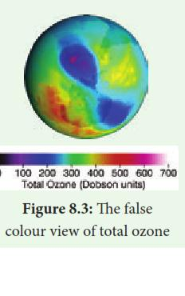
OZONE DEPLETION
Ozone layer ia a region of Earth’s stratosphere that absorbs most of the Sun’s ultra violet radiation. It acts as a protective shield for living rganisms.
The false colour view of total ozone-purple & blue colours are where there is the least ozone & the yellow & the reds are where there is more ozone.

Slide 5
AGRO & SOCIAL FORESTRY
Agroforestry is an integration of trees, crops,& livestock on the same plot
Agroforestry improves soil & water conservation, Nutrientcycling, provides balanced atmospheric temperature & relative humidity.
Social forestry refers to the management of forests & afforestati on on barren lands for helping social & rural development & benefits.
Activities of Social forestry
Training on tree growing methods
Raising & supply of seedlings on subsidy
Formation of demonstration plots
Publicity & awareness creation regarding tree growing

Slide 6
DEFORESTATION & AFFORESTATION
Deforestation is one of the major contributers to enhance green house effect & global warming
The causes for deforestation are conversion of agricultural plantation & livestock ranching,logging for timber,industrialisation,urbanisation & increased global needs.
To overcome deforestation Afforestation has to be carried out
Afforestation is planting of trees where there was no previous tree coverage & the conversion of non-forested lands into forests by planting suitable trees to retrieve vegetation.
It increases forest cover, rehabilitation of degraded forests,mixed plantation, awareness creation, monitoring & evaluation.

Slide 7
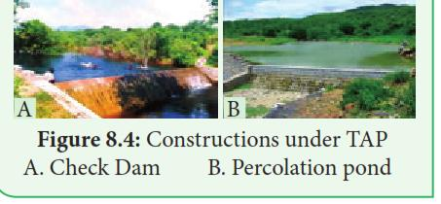
TAP PROJECTS

Slide 8
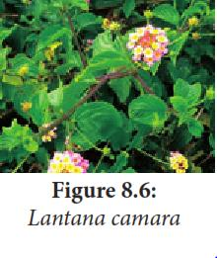
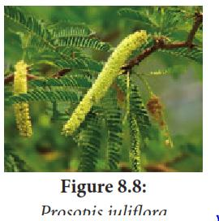
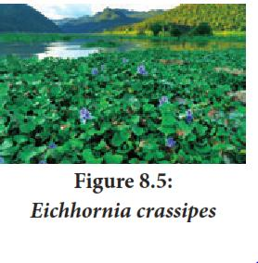
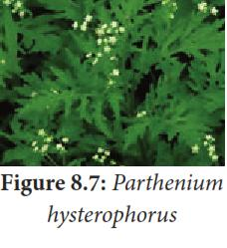
ALIEN INVASIVE SPECIES

Slide 9
A non –native species to the ecosystem or country under consideration that spreads naturally interferes with the bilgy & existance of native species, pses a serious threat to the ecosystem .
Eichhornia & Prosopis are native to South America.
Eichhornia leads to eutropication,a breeding habitat for mosquitoes , blocks sunlight & waterways hampering agriculture
Prosopis invades reducing the cver f native medicinal herbaceous
Species
Lantana & Parthenium are also native of South America &has allelopathic effect
Lantana reduces plant growth by inhibiting germination & root elongation
Parthenium causes pollen allergy which leads to allergic rhinitis, asthma,& dermatitis.

Slide 10
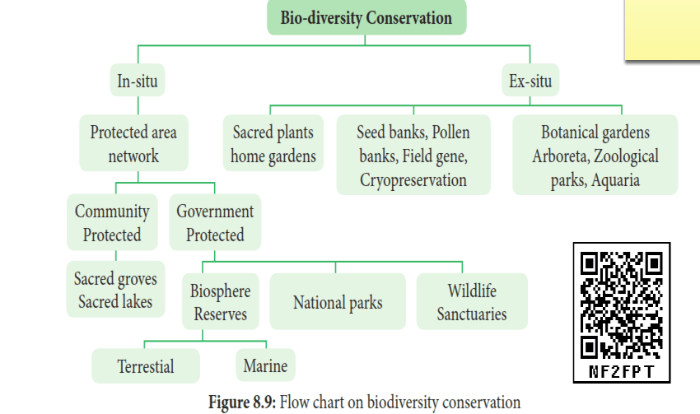
CONSERVATION

Slide 11
TYPES OF CONSERVATION
INSITU CONSERVATION
It means cnservation & management of genetic resources in their natural habitats.
SACRED GROVES
These are patches or grove of cultivated trees which are community protected & based on strong belief systems which usually have a significan
t religious connotation for protecting community.
EX-SITU CONSERVATION
It is a method of conservation where species are protected outside their natural environment.

Slide 12
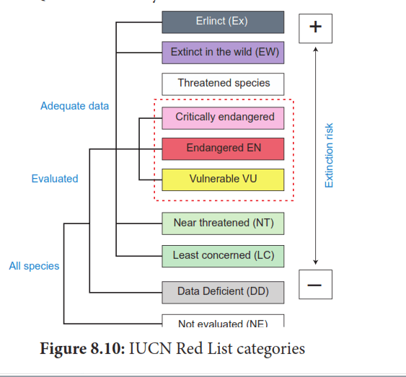
IUCN RED LIST

Slide 13
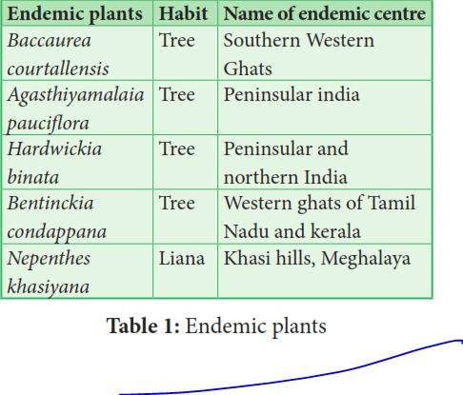
ENDEMIC CENTRES & ENDEMIC PLANTS

Slide 14
CARBON CAPTURE & STORAGE
Carbon capture & storage is a technology of capturing CO2 & inject it deep into the underground rocks into a depth of 1 km or more.
CARBON SEQUESTRATION
Carbon sequestration occurs naturally by plants & in ocean. Terrestrial sequestration is typically accomplished through forest & soil conservation practices that enhance the storage carbon.
CARBON FOOT PRINT
Carbon foot print is the total amount of green house gases produced by human activities such as agriculture, industries, deforestation, waste disposal, burning fossil fuels directly or indirectly.

Slide 15
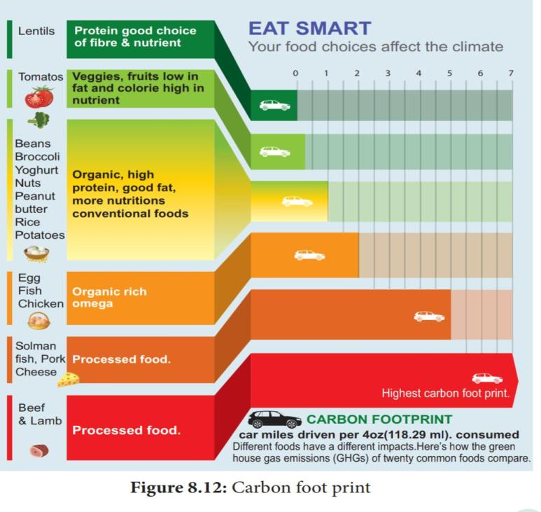

Slide 16
BIOCHAR
BIOCHAR is another long term method to store carbon. To increase plants ability to store more carbon, plants are partly burnt such as crop waste, waste woods to become carbon rich slow decomposing substances of material called Biochal.

Slide 17
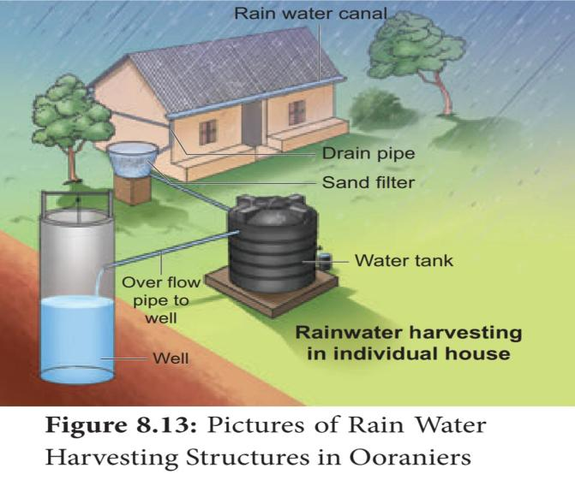
RAIN WATER HARVESTING

Slide 18
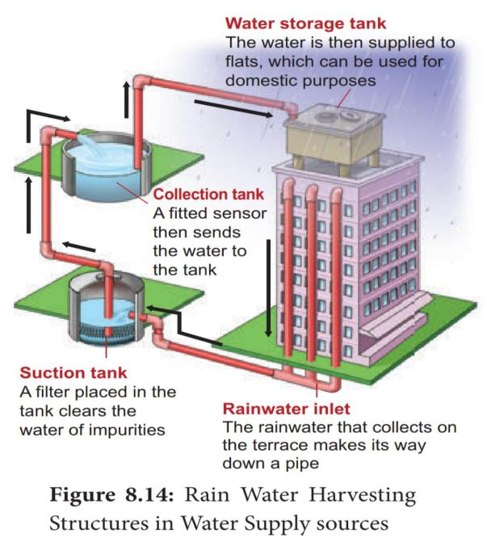

Slide 19
BENEFITS OF RAIN WATER HARVESTING
Promotes adequacy of underground water conservation
Mitigates the effect of drought
Reduces soil erosion as surface run off is reduced
Reduces flood hazards
Improves ground water quality & water table/ decreases salinity
No land is wasted for storage purpose & no population displacement is involved.
Storing water underground is an eco friendly measure & sustainable water storage strategy.

Slide 20
EIA & BIA
ENVIRONMENTAL IMPACT ASSESSMENT
BIODIVERSITY IMPACT ASSESSMENT
EIA is an environmental management tool.
It creates healthy atmosphere
Maintains Biodiversity
Decreases resource usage
Reduces gas emissions & environment damage
BIA can be defined as a decision supporting tool to help development , planning & implementation
They are legally complaint & include mechanisms for the conservation of bio-diversity resources & provide the benefits.

Slide 21
GIS & GPS
Geographic Information System
Geo positioning System
GIS is a computer system for capturing , storing , checking, & displaying data related to positions on Earth’s surface
Also to manipulate, analyse,manage & present spacial or geographical data
GPS is a satellite navigation system to determine the ground position of an object
It is currently used for mining, Aviation, Surveying,Agricultural & Marine ecosystem.

